Slide 1


Image Processing and Computer Vision: From Pixels to Intelligence
ITA0502 - COMPUTER VISION
SUPERVISOR
Presented By
V Sunil Kumar (192425292)
Dr.R C Jeni Gracia

Slide 2

01 / 05
INTR ODU CTIO N
Image Processing vs Computer Vision
A COMPARATIVE TECHNICAL ANALYSIS
•g Raw Digital Image
INPUT STREA M
Image Processing
ENHA NC E & FILTER
Image Processing
The technique of enhancing or modifying digital images to improve their quality for human interpretation or sto rage optimizatio n.
Enhanced Image
RE FINE D MATRIX 0UTPUT
Computer Vision
The computational pipeline that enables machines to analyze, extract features, model, and make semantic decisions based on visual inputs.

Slide 3
Core Distinctions
02 / 05
Image Processing
Primarily modifies pixel intensity matrices. Core operations include spatial kernel filtering, histogram normalization, and Fourier transforms to produce a corrected visual output.
t Parameter Image Processing Computer Vision
Primary Goal
Improves visual clarity & artifacts
Infers logical context & semantics
Typical Output
Modified 2D Image Matrix
Categorical predictions or state data
4D• Computer Vision
Interprets the multidimensional environment. It extracts higher-level abstractions like shape context, bounding boxes, or temporal vectors to draw structural inferences.
AI
Integration
Deterministic Algorithms (Frequencies)
Deep Learning & Neural Architectures
Complexity
Lower (linear/matrix transforms)
Higher (probabilistic decision boundary)

Slide 4
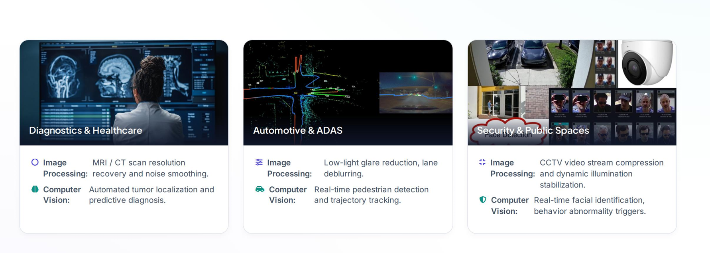
Industry Application Mapping
0 4 / 05

Slide 5
Conclusion
05 / 05
Core Framework Integration
Modern commercial AI systems do not isolate these tools. Robust platforms require continuous visual processing loops to handle unpredictability in physical light environments.
@ Visual Alignment: Image Processing corrects the lens errors and light variability, creating a standardized inputs package.
@ Actionable Intel: Computer Vision operates downstream, transforming preprocessed inputs into spatial intelligence.
@ Ubiquitous Deployment: Integrated systems guide modern industry across precision oncology, logistics automations, defense, and high-resolution Earth surveillance.
The Synergy Matrix
IMAGE PROCESSING
Improves, stabilizes, and recovers raw physical
signasinto a standard matnxformat
COMPUTER VISION
Synthesizes arrays into spatial semantic intelligence, triggering downstream system actions.

